Slide 1
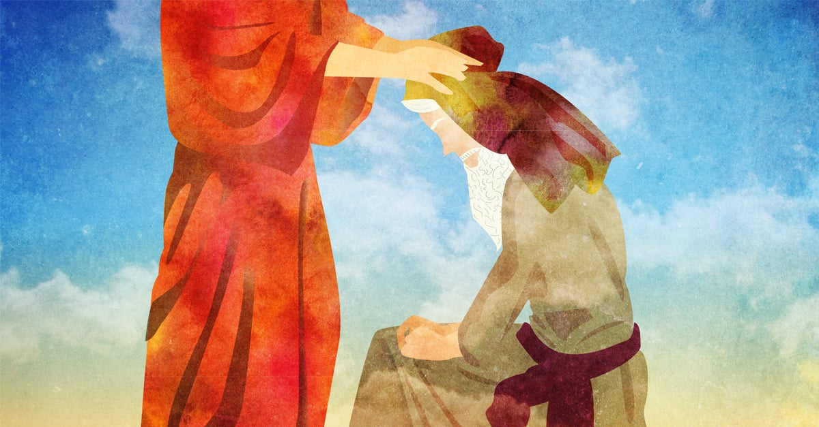
The leadership of Joshua!!
Be strong and courageous, for you shall cause this people to inherit the land that I swore to their fathers to give them… Joshua 1:6

Slide 2
Our year of the Lord’s glory!!
In the same way, let your light shine before others, so that they may see your good works and give glory to your Father who is in heaven… Matthew 5:16
1. To encourage a thorough understanding of the Glory of God.
2. To highlight how we as believers should live in order to glorify God.
3. To focus on soul winning and discipleship as key means of glorifying God.
Just like the cross, our vertical understanding of God and what glorifies him must be revealed in how we live and most importantly how we treat and serve others!! In this light a thing or two can be learnt by the review of biblical characters who glorified God by how they lived and served!!

Slide 3
The book of Joshua…
The book of Joshua is the 6th book of the bible and the old testament, It has 24 chapters which highlights the deliverance of the Israelites into the promise land. This typifies the deliverance of God’s children into God’s rest by Christ.
The book of Joshua was written to the descendants of those who conquered the land, as a historical account of how they had come to settle there. It celebrates God as general, defender, and king.
The book of Joshua shows the geographical boundaries given to each tribe of Israel.
This Book of the Law shall not depart from your mouth, but you shall meditate on it day and night, so that you may be careful to do according to all that is written in it. For then you will make your way prosperous, and then you will have good success… Joshua 1:8

Slide 4
The book of Joshua…
Chapter 1-5: Joshua leads Israel. Be strong and courageous, for you shall cause this people to inherit the land that I swore to their fathers to give them… Joshua 1:6
Chapter 6-12: Battles with Canaanites. Now these are the kings of the land whom the people of Israel defeated and took possession of their land beyond the Jordan toward the sunrise, from the Valley of the Arnon to Mount Hermon, with all the Arabah eastward… Joshua 12:1
Chapter 13-22: Joshua divides up the land. Now therefore divide this land for an inheritance to the nine tribes and half the tribe of Manasseh”… Joshua 13:7
Chapter 23-24: Joshua’s final words. “Now therefore fear the Lord and serve him in sincerity and in faithfulness. Put away the gods that your fathers served beyond the River and in Egypt, and serve the Lord. And if it is evil in your eyes to serve the Lord, choose this day whom you will serve, whether the gods your fathers served in the region beyond the River, or the gods of the Amorites in whose land you dwell. But as for me and my house, we will serve the Lord”… Joshua 24:14-15

Slide 5
The leadership of Joshua!!
Who was Joshua???
Joshua’s name was Hoshea before being changed to Joshua by Moses which means God’s Salvation. (Numbers 13:16)
Joshua was born in Egypt, he became the leader at the age of 85, led the Israelites for 25years and died at 110. (Judges 2:8)
Joshua was a man of faith as seen in how he and Caleb reported after being sent out as spies by Moses. (Numbers 13:30)
Joshua was courageous as seen in his approach to the many victorious battles he led the Israelites in given by the Lord. (Joshua 1:6)
Joshua was dedicated to God and His word. (Joshua 1:8, 24:14-15)

Slide 6
The leadership of Joshua!!... Chapter 1
Joshua as a leader made it his primary focus to obey the commandments of God!! He understood that as his prime responsibility to be able to lead the people of God!!
8. This Book of the Law shall not depart from your mouth, but you shall meditate on it day and night, so that you may be careful to do according to all that is written in it. For then you will make your way prosperous, and then you will have good success. 9. Have I not commanded you? Be strong and courageous. Do not be frightened, and do not be dismayed, for the Lord your God is with you wherever you go”… Joshua 1:8-9

Slide 7
The leadership of Joshua!!... Chapter 2
Joshua as a leader understood the importance of strategy and planning. He showed this by how he sent out spies.
1. And Joshua the son of Nun sent two men secretly from Shittim as spies, saying, “Go, view the land, especially Jericho.” And they went and came into the house of a prostitute whose name was Rahab and lodged there.
23. Then the two men returned. They came down from the hills and passed over and came to Joshua the son of Nun, and they told him all that had happened to them. 24. And they said to Joshua, “Truly the Lord has given all the land into our hands. And also, all the inhabitants of the land melt away because of us”….. Joshua 2

Slide 8
The leadership of Joshua!!... Chapter 3-4
Joshua as a leader did not back away from challenges. He welcomed them and overcame them as seen in how Israel crossed the Jordan into the promise land.
15. and as soon as those bearing the ark had come as far as the Jordan, and the feet of the priests bearing the ark were dipped in the brink of the water (now the Jordan overflows all its banks throughout the time of harvest), 16. the waters coming down from above stood and rose up in a heap very far away, at Adam, the city that is beside Zarethan, and those flowing down toward the Sea of the Arabah, the Salt Sea, were completely cut off. And the people passed over opposite Jericho. 17. Now the priests bearing the ark of the covenant of the Lord stood firmly on dry ground in the midst of the Jordan, and all Israel was passing over on dry ground until all the nation finished passing over the Jordan……. Joshua 3

Slide 9
The leadership of Joshua!!... Chapter 5
Joshua as a leader was interested in following and fulfilling the will of God and not being swayed by his interests or what would have seemingly looked good.
13. When Joshua was by Jericho, he lifted up his eyes and looked, and behold, a man was standing before him with his drawn sword in his hand. And Joshua went to him and said to him, “Are you for us, or for our adversaries?” 14. And he said, “No; but I am the commander of the army of the Lord. Now I have come.” And Joshua fell on his face to the earth and worshiped and said to him, “What does my lord say to his servant?” 15. And the commander of the Lord's army said to Joshua, “Take off your sandals from your feet, for the place where you are standing is holy.” And Joshua did so……. Joshua 5

Slide 10
Conclusion
As leaders in our own capacities, are we showing strength and courage in the Lord?
What can we learn from the leadership of Joshua to improve our lives today?
What does success to us look like?
Are we giving glory to God?
Be strong and courageous, for you shall cause this people to inherit the land that I swore to their fathers to give them… Joshua 1:6
Let us pray…

