Slide 1
Luke 10 -At the Home of Martha and Mary
³⁸ As Jesus and his disciples were on their way, he came to a village where a woman named Martha opened her home to him. ³⁹ She had a sister called Mary, who sat at the Lord’s feet listening to what he said. ⁴⁰ But Martha was distracted by all the preparations that had to be made. She came to him and asked, “Lord, don’t you care that my sister has left me to do the work by myself? Tell her to help me!”
⁴¹ “Martha, Martha,” the Lord answered, “you are worried and upset about many things, ⁴² but few things are needed—or indeed only one.^{[f]} Mary has chosen what is better, and it will not be taken away from her.”

Slide 2
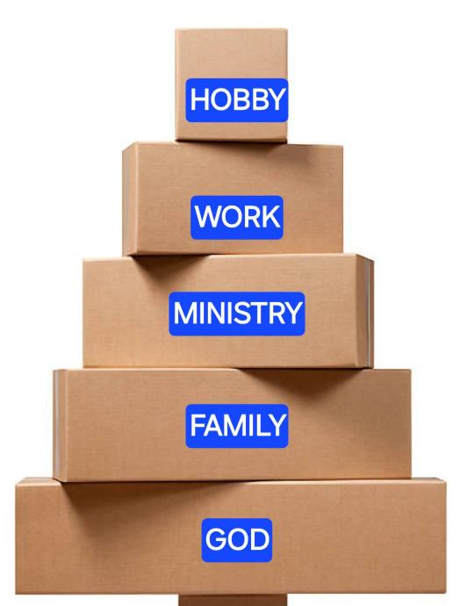

Slide 3
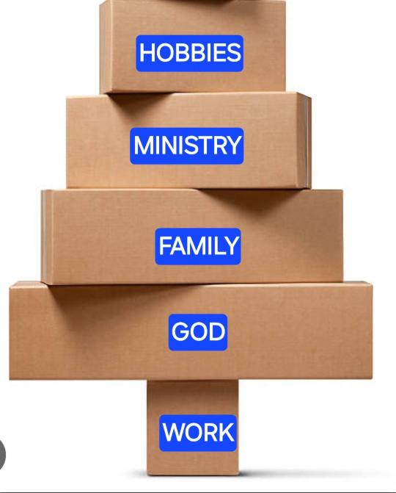

Slide 5
Exodus 34:4-7 NIV
⁴ So Moses chiseled out two stone tablets like the first ones and went up Mount Sinai early in the morning, as the Lord[YAHWEH] had commanded him; and he carried the two stone tablets in his hands. ⁵ Then the Lord[YAHWEH]
came down in the cloud and stood there with him and proclaimed his name, the Lord[YAHWEH] . ⁶ And he passed in front of Moses, proclaiming, “The Lord[YAHWEH] , the
Lord[YAHWEH] , the compassionate and gracious God, slow to anger, abounding in love and faithfulness,
⁷ maintaining love to thousands, and forgiving wickedness, rebellion and sin. Yet he does not leave the guilty unpunished; he punishes the children and their children for the sin of the parents to the third and fourth generation.”

Slide 6
Compassionate and Gracious
Hebrew = rahum we-hanun
Compassionate = rahum
translates Merciful Or “Female Womb”
To feel
Gracious = we-hanun
To show grace ; to show favor ; to take action

Slide 7
First, is based on what we have done… sounds like:
‘God , im a good person, I go to church, I pray,
I volunteer, I give money, Would you __________’
Second, ‘God, things are really bad right now,
im struggling, How could you allow this to happen
to me? Its not fair, so would you ____________’
Third, ‘God, you are compassionate-you care about me.
And you are Gracious-you want to help.
And God, you don’t owe me a thing, and there
are many many many other people who have
things way worse than I do., but based on your
mercy, I ask you to__________’

Slide 8
Exodus 34:4-7 NIV
⁴ So Moses chiseled out two stone tablets like the first ones and went up Mount Sinai early in the morning, as the Lord[YAHWEH] had commanded him; and he carried the two stone tablets in his hands. ⁵ Then the Lord[YAHWEH]
came down in the cloud and stood there with him and proclaimed his name, the Lord[YAHWEH] . ⁶ And he passed in front of Moses, proclaiming, “The Lord[YAHWEH] , the
Lord[YAHWEH] , the compassionate and gracious God,
slow to anger, abounding in love and faithfulness,
⁷ maintaining love to thousands, and forgiving wickedness, rebellion and sin. Yet he does not leave the guilty unpunished; he punishes the children and their children for the sin of the parents to the third and fourth generation.”

Slide 9
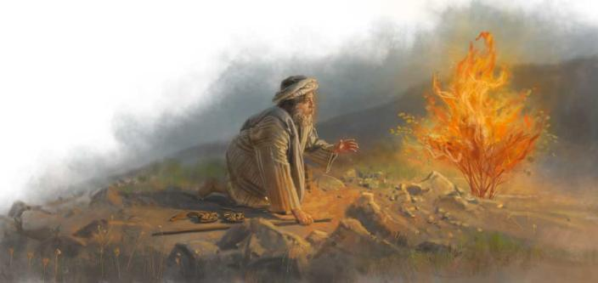
Exodus 3:13 & 34:6
Moses asked:
Mah Shemo? Which translates
“What is his name?”
1st Compassionate and Gracious
2nd Slow to Anger
Erek apayim
‘Long Nostils’

Slide 10
Our Anger | God's Anger
usually from wounded pride / ego | stems from a parent-like love for his children
inherently selfish | protective of his people
disproportionate to the offense | the punishment fits the crime
quick to flare up | on tempo, patiently building up to the right moment

Slide 11
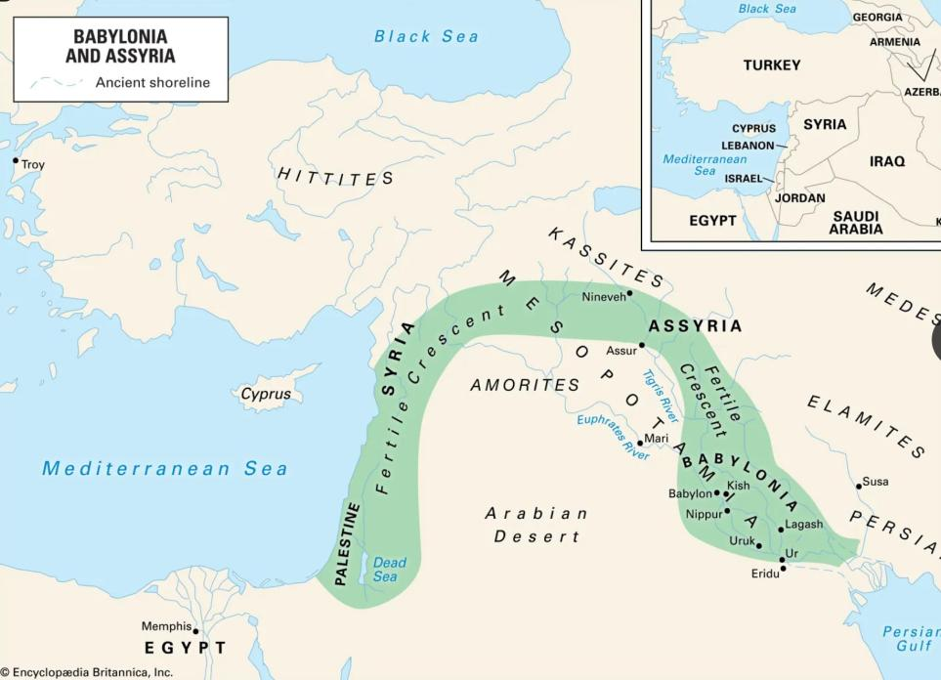


Slide 12
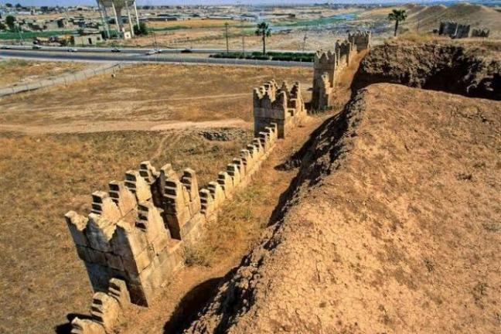
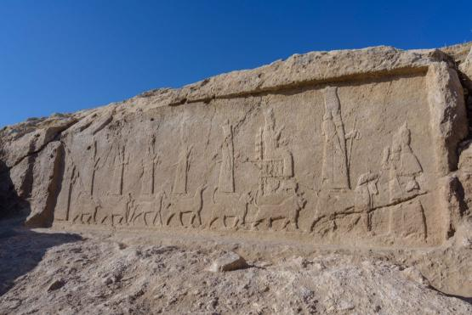
Today
Mosul, Ira

Slide 13
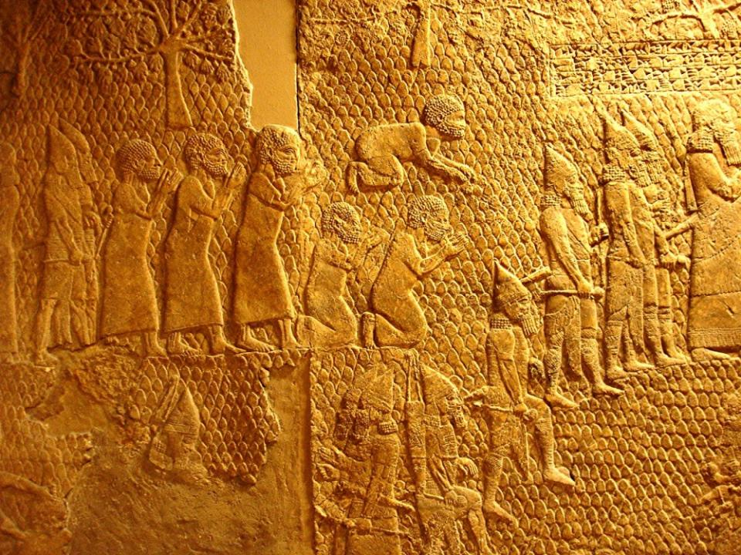

Slide 14
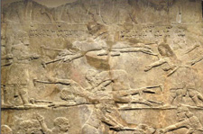
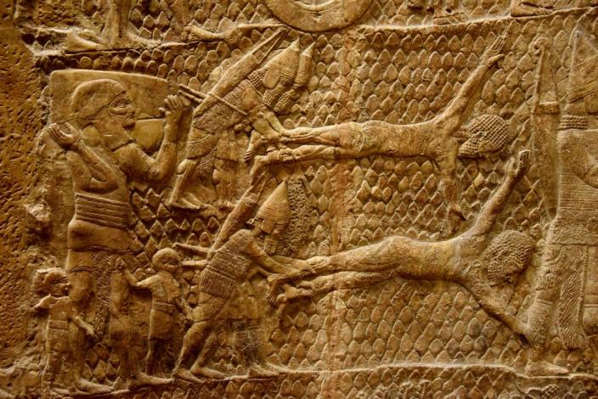

Slide 15
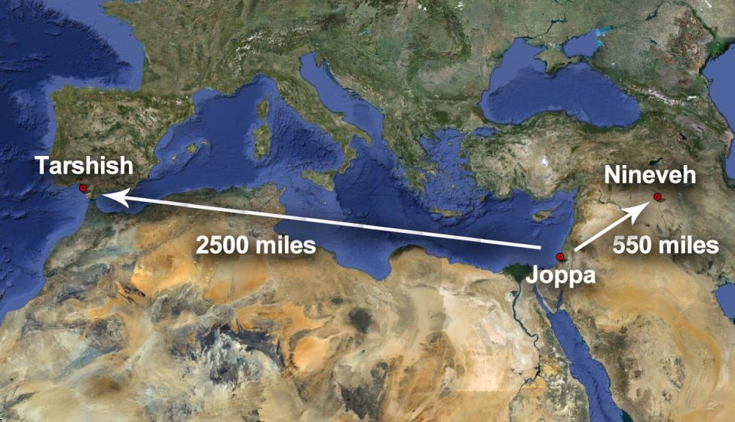

Slide 16
Nahum 1 150 years later
1 A prophecy concerning Nineveh. The book of the vision of Nahum the Elkoshite.
The Lord’s Anger Against Nineveh
² The Lord is a jealous and avenging God;
the Lord takes vengeance and is filled with wrath.
The Lord takes vengeance on his foes
and vents his wrath against his enemies.
³ The Lord is slow to anger but great in power;
the Lord will not leave the guilty unpunished.
His way is in the whirlwind and the storm,
and clouds are the dust of his feet.
……….
¹⁴ The Lord has given a command concerning you, Nineveh:
“You will have no descendants to bear your name.
I will destroy the images and idols
that are in the temple of your gods.
I will prepare your grave,
for you are vile.”

Slide 17
Genesis 15 Lord is promising Abraham a great nation and promise land
¹³ Then the Lord said to him, “Know for certain that for four hundred years your descendants will be strangers in a country not their own and that they will be enslaved and mistreated there. ¹⁴ But I will punish the nation they serve as slaves, and afterward they will come out with great possessions. ¹⁵ You, however, will go to your ancestors in peace and be buried at a good old age. ¹⁶ In the fourth generation your descendants will come back here, for the sin of the Amorites has not yet reached its full measure.”
Joshua 10 and 11
The Lord gave them in to the hands of the Israelites.

Slide 18
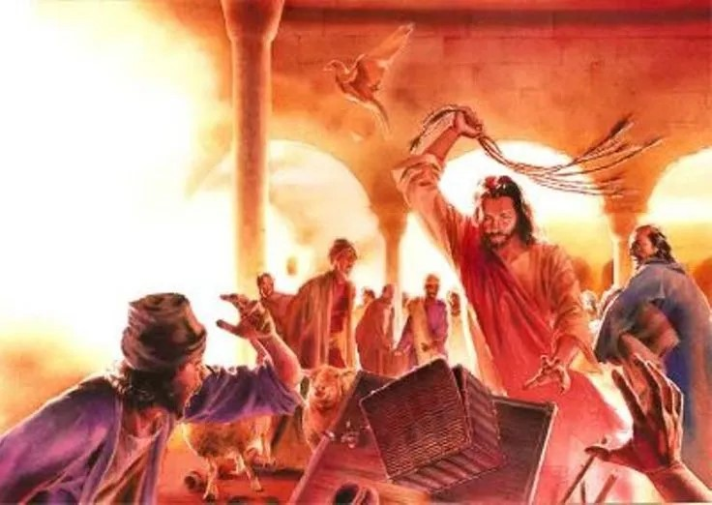
John 2:15 Jesus made a whip from some ropes and chased them all out of the Temple. He drove out the sheep and cattle, scattered the money changers’ coins over the floor, and turned over their tables.

Slide 19
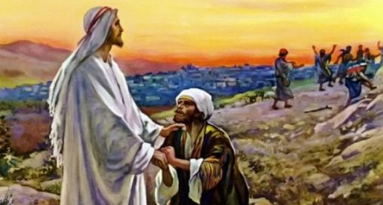
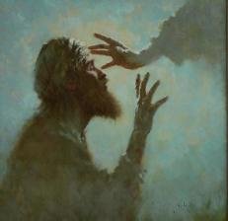
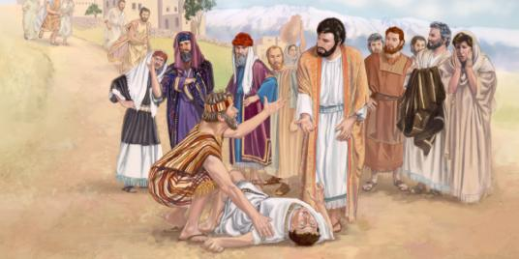
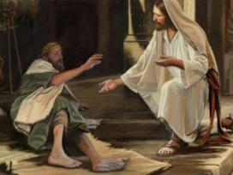
1 John 4:8
Whoever does not love does not know God, because God is love.
Luke 17 “Master, they said, have mercy on us!”
Luke 18 “Jesus, Son of David, have mercy on me!”
Matthew 17 “Lord, have mercy on my son”

Slide 20
Exodus 34:4-7 NIV
⁴ So Moses chiseled out two stone tablets like the first ones and went up Mount Sinai early in the morning, as the Lord[YAHWEH] had commanded him; and he carried the two stone tablets in his hands. ⁵ Then the Lord[YAHWEH]
came down in the cloud and stood there with him and proclaimed his name, the Lord[YAHWEH] . ⁶ And he passed in front of Moses, proclaiming, “The Lord[YAHWEH] , the
Lord[YAHWEH] , the compassionate and gracious God, slow to anger, abounding in love and faithfulness,
⁷ maintaining love to thousands, and forgiving wickedness, rebellion and sin. Yet he does not leave the guilty unpunished; he punishes the children and their children for the sin of the parents to the third and fourth generation.”

Slide 21
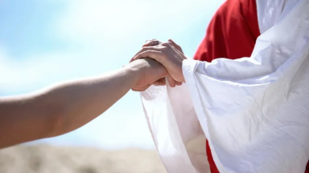
"Sin" is it's own punishment and "righteousness" it's own reward
Romans 1:24-28
²⁴ Therefore God gave them over in the sinful desires of their hearts to sexual impurity for the degrading of their bodies with one another. ²⁵ They exchanged the truth about God for a lie, and worshiped and served created things rather than the Creator—who is forever praised. Amen.
²⁶ Because of this, God gave them over to shameful lusts. Even their women exchanged natural sexual relations for unnatural ones. ²⁷ In the same way the men also abandoned natural relations with women and were inflamed with lust for one another. Men committed shameful acts with other men, and received in themselves the due penalty for their error.
²⁸ Furthermore, just as they did not think it worthwhile to retain the knowledge of God, so God gave them over to a depraved mind, so that they do what ought not to be done.

Slide 22

YAHWEH

