Slide 1
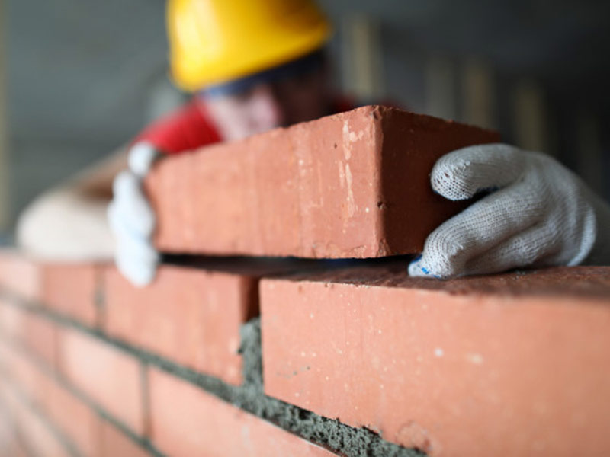
The word of God at work in us! And we also thank God constantly for this, that when you received the word of God, which you heard from us, you accepted it not as the word of men but as what it really is, the word of God, which is at work in you believers… 1Thessalonians 2:13

Slide 2
The power of the Gospel – 1Thessalonians 1:4-10
4. For we know, brothers loved by God, that he has chosen you, 5. because our gospel came to you not only in word, but also in power and in the Holy Spirit and with full conviction. You know what kind of men we proved to be among you for your sake. 6. And you became imitators of us and of the Lord, for you received the word in much affliction, with the joy of the Holy Spirit, 7. so that you became an example to all the believers in Macedonia and in Achaia. 8. For not only has the word of the Lord sounded forth from you in Macedonia and Achaia, but your faith in God has gone forth everywhere, so that we need not say anything. 9. For they themselves report concerning us the kind of reception we had among you, and how you turned to God from idols to serve the living and true God, 10. and to wait for his Son from heaven, whom he raised from the dead, Jesus who delivers us from the wrath to come.

Slide 3
The power of the Gospel – 1Thessalonians 1:4-10
1. There is power in the Gospel unto salvation by the work of the Holy Spirit.
2. The received Gospel causes us to be disciples of Christ!!
3. The Gospel sparks joy in the heart of the believer.
4. We become an example in word and works.
5. There is a genuine turn from every other god as we hope in Christ and await His second coming.

Slide 4
Our salvation in Christ through the Gospel…
Now may the God of peace himself sanctify you completely, and may your whole spirit and soul and body be kept blameless at the coming of our Lord Jesus Christ. 1Thessalonians 5:23
The spirit is saved instantly – He has delivered us from the domain of darkness and transferred us to the kingdom of his beloved Son… Colossians 1:13
The soul is progressively saved – Do not be conformed to this world,[a] but be transformed by the renewal of your mind, that by testing you may discern what is the will of God, what is good and acceptable and perfect… Romans 12:2
The body will be saved at the appearance of Christ - Beloved, we are God's children now, and what we will be has not yet appeared; but we know that when he appears we shall be like him, because we shall see him as he is… 1John 3:2

Slide 5
The word of God at work in us!
13. And we also thank God constantly for this, that when you received the word of God, which you heard from us, you accepted it not as the word of men but as what it really is, the word of God, which is at work in you believers. 14. For you, brothers, became imitators of the churches of God in Christ Jesus that are in Judea. For you suffered the same things from your own countrymen as they did from the Jews, 1Thessalonians 2:13-14

Slide 6
The word of God at work in us!
The word of God builds us up – And now I commend you to God and to the word of his grace, which is able to build you up and to give you the inheritance among all those who are sanctified… Acts 20:32
The word of God renews our mind – Have this mind among yourselves, which is yours in Christ Jesus… Philippians 2:5
The word of God changes our desires – You have loved righteousness and hated wickedness, therefore God, your God, has anointed you with the oil of gladness beyond your companions… Hebrews 1:9
Let us pray…

