Slide 1
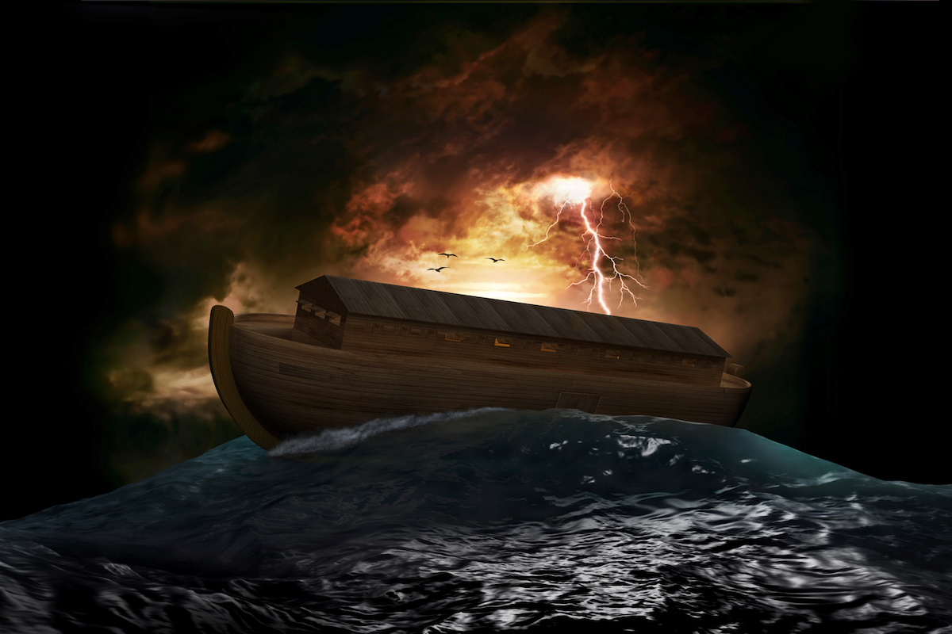
Alex
Character Study: “Lessons from NOAH”
“The Day of the Lord”
” [37] For as were the days of Noah, so will be the coming of the Son of Man.
[38] For as in those days before the flood they were eating and drinking, marrying and giving in marriage, until the day when Noah entered the ark,
[39] and they were unaware until the flood came and swept them all away, so will be the coming of the Son of Man”.
Matthew 24:37-39

Slide 2
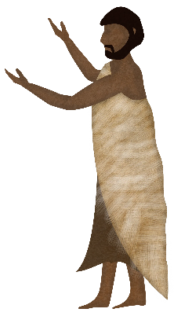
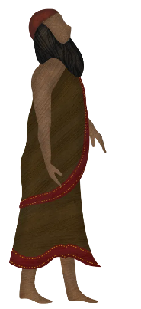
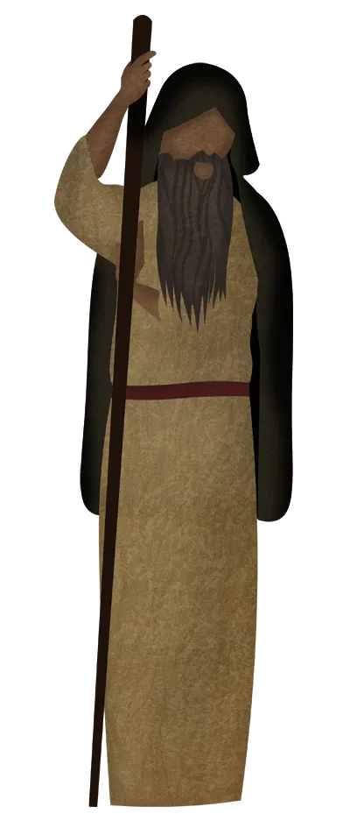
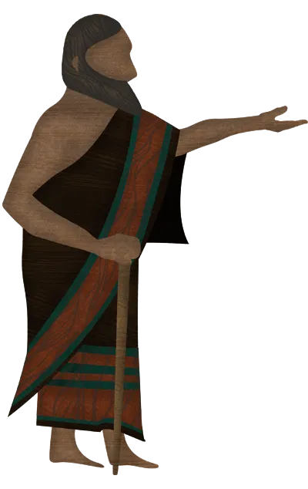
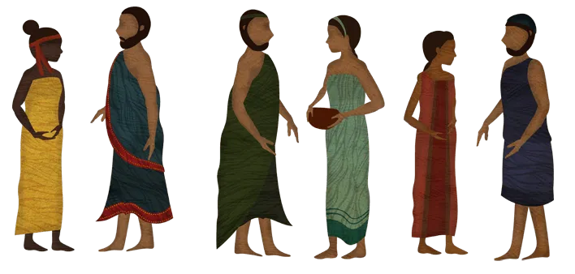
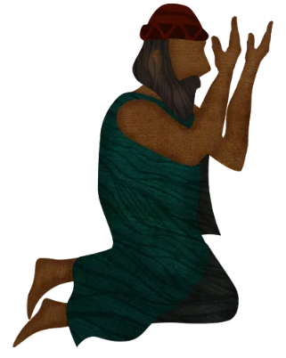
“Genealogy of Noah”
Adam (Gens 2:7)
[28] When Lamech had lived 182 years, he fathered a son [29] and called his name Noah, saying, “Out of the ground that the Lord has cursed, this one shall bring us relief from our work and from the painful toil of our hands.”
Genesis 5:28-29
Enoch (Gens 5:18)
Methuselah(Gens 5:21)
“NOAH” (Gens 5:28
Lamech (Gens 5:26
Shem, Ham, and Japheth(Gens 5:32)

Slide 3
“Wickedness and Corrupt practices abound on earth”
[1] When man began to multiply on the face of the land and daughters were born to them, [2] the sons of God saw that the daughters of man were attractive. And they took as their wives any they chose. [3] Then the Lord said, “My Spirit shall not abide in man forever, for he is flesh: his days shall be 120 years.” [4] The Nephilim were on the earth in those days, and also afterward, when the sons of God came in to the daughters of man and they bore children to them. These were the mighty men who were of old, the men of renown. [5] The Lord saw that the wickedness of man was great in the earth, and that every intention of the thoughts of his heart was only evil continually.
Genesis 6:1- 6

Slide 4
“God’s judgement on the earth” – Gens 6:7-8
[6] And the Lord regretted that he had made man on the earth, and it grieved him to his heart. [7] So the Lord said, “I will blot out man whom I have created from the face of the land, man and animals and creeping things and birds of the heavens, for I am sorry that I have made them.”
[8] But Noah found favor in the eyes of the Lord.
Genesis 6:6- 8

Slide 5
[15] Do not love the world or the things in the world. If anyone loves the world, the love of the Father is not in him. [16] For all that is in the world—the desires of the flesh and the desires of the eyes and pride of life—is not from the Father but is from the world.”
Why did God choose Noah- Gens 6:8-10
We are in the world but not of this world– 1 John 2:15
Further Reading: Cols 3:2, Psalms 1:1-3, Phil 2:15

Slide 6
[17] For behold, I will bring a flood of waters upon the earth to destroy all flesh in which is the breath of life under heaven. Everything that is on the earth shall die. [18] But I will establish my covenant with you, and you shall come into the ark, you, your sons, your wife, and your sons’ wives with you. [19] And of every living thing of all flesh, you shall bring two of every sort into the ark to keep them alive with you. They shall be male and female. [20] Of the birds according to their kinds, and of the animals according to their kinds, of every creeping thing of the ground, according to its kind, two of every sort shall come in to you to keep them alive.
God’s Judgement and Salvation- Gens 6:17-20
God, the righteous Judge – Psalms 9:7-8
Further Reading: Is 33:22, 2 Tim 4:8, Roms 2:5-6,Rev 20;11-12

Slide 7
Character Study: “Lessons from NOAH”
A call to stand out (Gens 6:8-9) – Deut 14:2, Roms 12:1-2, 1 Peter 2:9
Complete Obedience (Gens 6:22) –1 Sam 15:22
Faith in God (Gens 7:1-5) - Hebs 11:7, 1 Thess 5:24
Waiting on God (7:11-24) – Is 40:29-31, Ps 27:14, Roms 8:25
God Mercy and Salvation (Gens 8:1) – Lams 3:22-23, Ps 103:8-12
God honors Sacrifice (Gens 8:20-22) – Hebs 13:15 Ps 50:23
A new beginning , a new covenant (Gens 9:8-17) – Jer 31:31-33

Slide 8
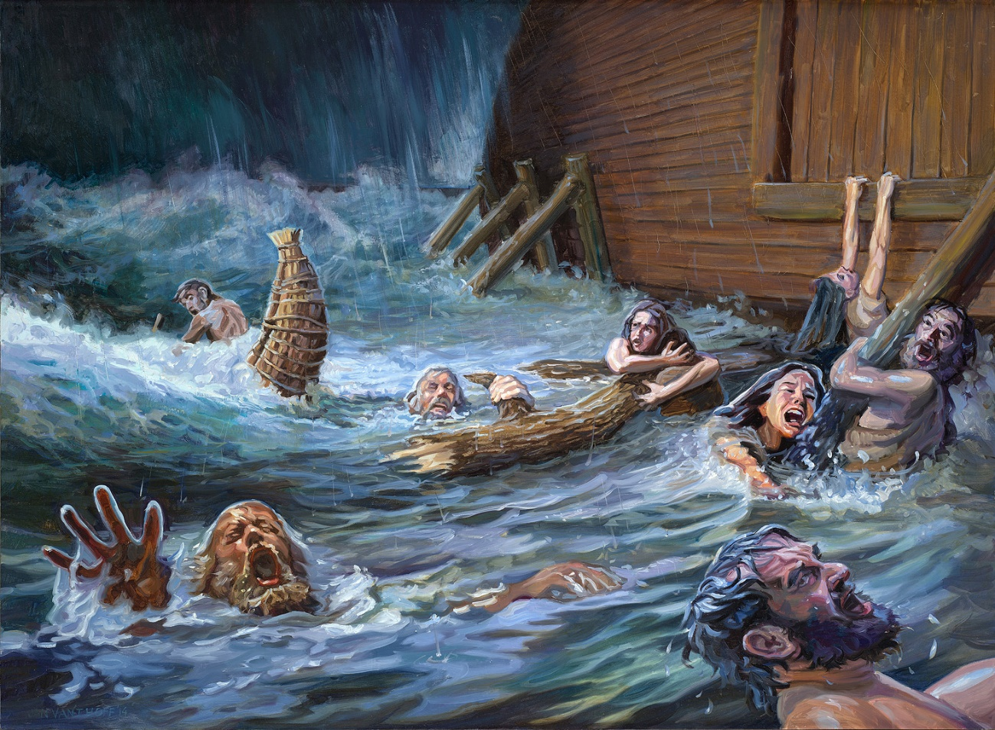
Retrospect…Are we ready for “The day of the Lord” ?
“The Day of the Lord”
” [37] For as were the days of Noah, so will be the coming of the Son of Man.
[38] For as in those days before the flood they were eating and drinking, marrying and giving in marriage, until the day when Noah entered the ark,
[39] and they were unaware until the flood came and swept them all away, so will be the coming of the Son of Man”.
Matthew 24:37-39

Slide 9
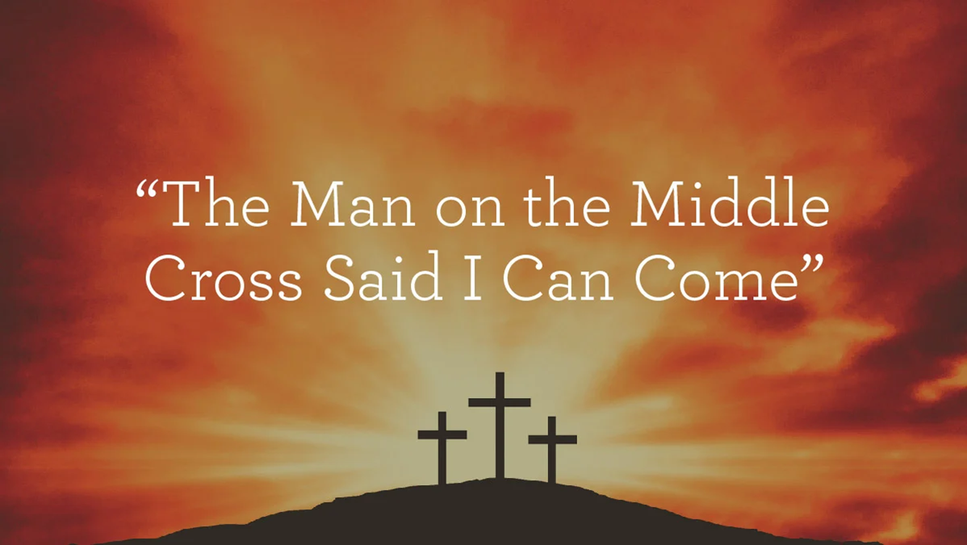
Jesus Christ the symbol of the divine ark – Acts 4:12
[8] but God shows his love for us in that while we were still sinners,
Christ died for us.
Romans 5:8
Jesus Christ came so we can be Saved from judgement of the world.. Come into the ark!

