Slide 1
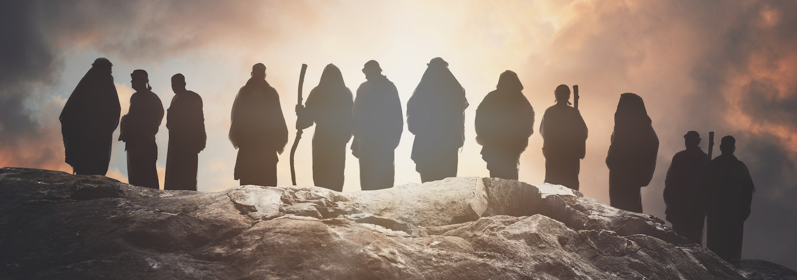
DISCIPLESHIP!! – Part 2.
until we all attain to the unity of the faith and of the knowledge of the Son of God, to mature manhood, to the measure of the stature of the fullness of Christ… Ephesians 4:13

Slide 2
Characteristics of discipleship…
Commitment to Christ: Discipleship requires a wholehearted commitment to Jesus. This indicates a life of self-denial and dedication to Christ's mission.
Obedience to His Teachings: A disciple is expected to obey the teachings of Jesus. Living according to the Word of God. (John 8:31)
Transformation and Growth: Discipleship involves spiritual growth and transformation into the likeness of Christ. (Romans 12:2)
Bearing Fruit: A true disciple bears spiritual fruit as evidence of their faith and journey in Christ. (John 15:8)
Love for Others: Love is a hallmark of discipleship. Love for God and love for others even our enemies. (John 13:34-35)

Slide 3
Pillars of a biblical disciple…
Reading and studying the bible: Study to show thyself approved unto God, a workman that needs not to be ashamed, rightly dividing the word of truth… 2Timothy2:15 - KJV
Prayer: Pray without ceasing… 1Thessalonians5:17
Meditation: This Book of the Law shall not depart from your mouth, but you shall meditate on it day and night, so that you may be careful to do according to all that is written in it. For then you will make your way prosperous, and then you will have good success… Joshua1:8
Obedience: And Samuel said, “Has the Lord as great delight in burnt offerings and sacrifices, as in obeying the voice of the Lord? Behold, to obey is better than sacrifice, and to listen than the fat of rams… 1Samuel 15:22

Slide 4
Pillars of biblical discipleship…
Him we proclaim, warning everyone and teaching everyone with all wisdom, that we may present everyone mature in Christ. For this I toil, struggling with all his energy that he powerfully works within me… Colossians 1:28-29
The what: Proclaim Christ!!
The how: Teaching and warning with wisdom…
The goal: To present everyone mature in Christ…
The place of toil & struggle…
The place of “His energy” at work in us….

Slide 5
Recommendations to being an effective disciple…
Plan… make time… execute.
Engage your family & choose good friends.
Church and small group meetings.
Serve!!!

Slide 6
Recommendations for effective discipleship…
Mentorship & accountability.
  Maturity
  Availability
  Interest
Issues of opposite sex.
Being intentional with time & resources.
Pray more than you talk.
Be encouraging.

