Slide 1
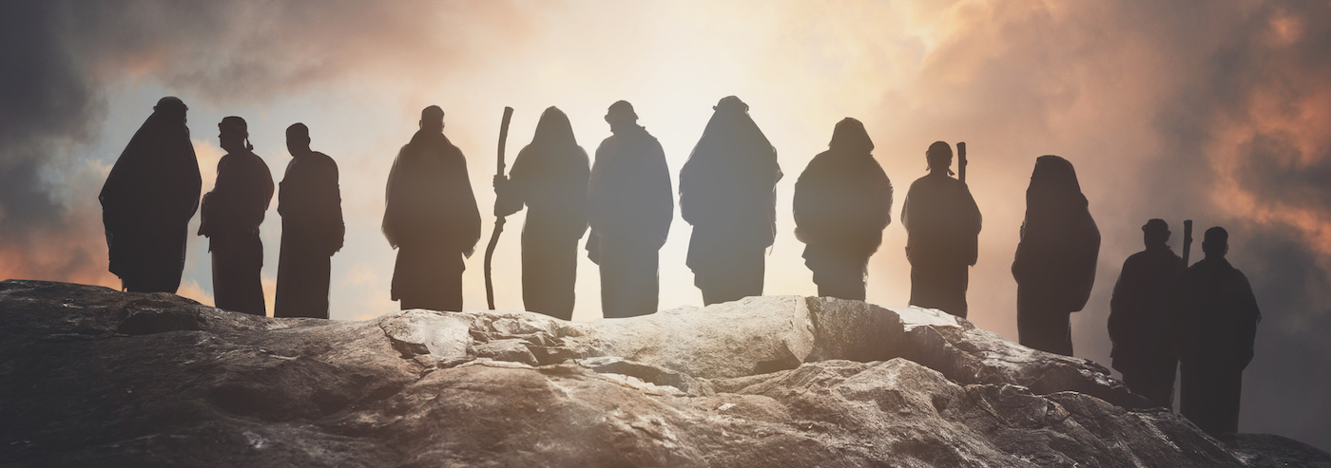
DISCIPLESHIP!!
Then Jesus told his disciples, “If anyone would come after me, let him deny himself and take up his cross and follow me…
Matthew 16:24

Slide 2
Discipleship…
The term originates from the Latin word "discipulus," meaning "learner" or "pupil.“
In the new testament the Greek word "mathētēs” is used, which also means "learner" or "follower."
In simple definition, discipleship refers to the process of following Jesus Christ and adhering to His teachings. A disciple is one who is born again and is on a lifelong journey of following Jesus, marked by commitment, obedience, transformation, and love.

Slide 3
Discipleship…
Discipleship is both a personal (Matt 16:24) and communal endeavor (Matt 28:19-20), empowered by the Holy Spirit and grounded in the teachings of Jesus Christ.
Discipleship is not mentioned in the bible. However, disciple occurs in all the gospels and the book of Acts, and carries a similar radiance as the word Christian; depicting a journey in and with Christ.
Beyond a church practice, discipleship is an obligation every believer owes to Christ for His sacrificial and exemplary life for our election, redemption, justification, sanctification, adoption, and regeneration

Slide 4
The personal journey of discipleship…
Then Jesus told his disciples, “If anyone would come after me, let him deny himself and take up his cross and follow me… Matthew 16:24
If we endure, we will also reign with him; if we deny him, he also will deny us; if we are faithless, he remains faithful… 2Timothy 2:12-13
And whoever does not take his cross and follow me is not worthy of me. Whoever finds his life will lose it, and whoever loses his life for my sake will find it… Matthew 10:38-39

Slide 5
The communal endeavor of discipleship…
Go therefore and make disciples of all nations, baptizing them in the name of the Father and of the Son and of the Holy Spirit, teaching them to observe all that I have commanded you. And behold, I am with you always, to the end of the age”… Matthew 28:19-20
When they had preached the gospel to that city and had made many disciples, they returned to Lystra and to Iconium and to Antioch… Acts14:21
And he said to them, “Go into all the world and proclaim the gospel to the whole creation. Whoever believes and is baptized will be saved, but whoever does not believe will be condemned… Mark16:15-16

Slide 6
Characteristics of discipleship…
Commitment to Christ: Discipleship requires a wholehearted commitment to Jesus. This indicates a life of self-denial and dedication to Christ's mission.
Obedience to His Teachings: A disciple is expected to obey the teachings of Jesus. Living according to the Word of God. (John 8:31)
Transformation and Growth: Discipleship involves spiritual growth and transformation into the likeness of Christ. (Romans 12:2)
Bearing Fruit: A true disciple bears spiritual fruit as evidence of their faith and journey in Christ. (John 15:8)
Love for Others: Love is a hallmark of discipleship. Love for God and love for others even our enemies. (John 13:34-35)

Slide 7
What then is a true disciple? Or what does Jesus mean by saying, “you are truly my disciples”? Let’s be really clear here: For Jesus “true disciple” is the same as “true Christian” or “true believer.” Jesus is not saying that “true disciple” is a second stage in the Christian life. First believer, and then later you attain the level of disciple. No!! If you are a true Christian or true believer you are a true disciple.
John Piper

