Slide 1
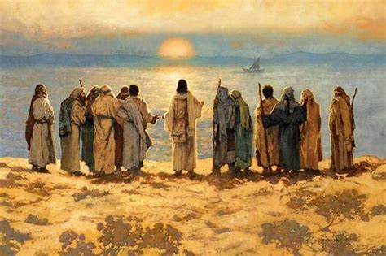
Discipleship
The conclusion.
And he appointed twelve (whom he also named apostles) so that they might be with him and he might send them out to preach…. Mark 3:14

Slide 2
Saved to save…
13. And he went up on the mountain and called to him those whom he desired, and they came to him. 14. And he appointed twelve (whom he also named apostles) so that they might be with him and he might send them out to preach 15. and have authority to cast out demons. 16. He appointed the twelve: Simon (to whom he gave the name Peter); 17. James the son of Zebedee and John the brother of James (to whom he gave the name Boanerges, that is, Sons of Thunder); 18. Andrew, and Philip, and Bartholomew, and Matthew, and Thomas, and James the son of Alphaeus, and Thaddaeus, and Simon the Zealot, 19. and Judas Iscariot, who betrayed him

Slide 3
Saved to save…
Simon Peter – Served in Antioch & martyred in Rome.
James the son of Zebedee – Served in Jerusalem & martyred there by Herold.
John the brother of James – Wrote letters from Patmos & died naturally.
Andrew – Served Greek communities & martyred in Patras.
Philip – Served Greek communities & was martyred.
Bartholomew – encouraged early churches & was martyred.
Matthew – Served in the Mediterranean & was martyred in Ethiopia.
Thomas – Served in India & was martyred there.
James the son of Alphaeus – Served in Jerusalem & was martyred by stoning.
Thaddaeus – Served and was martyred in Armenia.
Simon the Zealot – Served early churches & martyred in Beirut.
Judas Iscariot – He hung himself after betraying Jesus.

Slide 4
Importance of Discipleship…
Growth and maturity of the Christian – But grow in the grace and knowledge of our Lord and Savior Jesus Christ… 2Peter 3:18
Provides accountability & community – Iron sharpens iron, and one man sharpens another… Proverbs 27:17
Deals with the issue of backsliding – Watch and pray that you may not enter into temptation… Matthew 26:41
Encourages the growth of the Church – So the church throughout all Judea and Galilee and Samaria had peace and was being built up. And walking in the fear of the Lord and in the comfort of the Holy Spirit, it multiplied… Acts 9:31
Establishes the Kingdom of God on earth – Your kingdom come, your will be done, on earth as it is in heaven… Matthew 6:10

Slide 5
Discussion questions…
Define discipleship and share what you have learnt from the series on discipleship?
Take turns to share how we can become effective disciples of Jesus Christ?
What are the hindrances to effective discipleship in the church and how can we encourage discipleship in the church?
Spend time praying for the Church in China.

