Slide 1
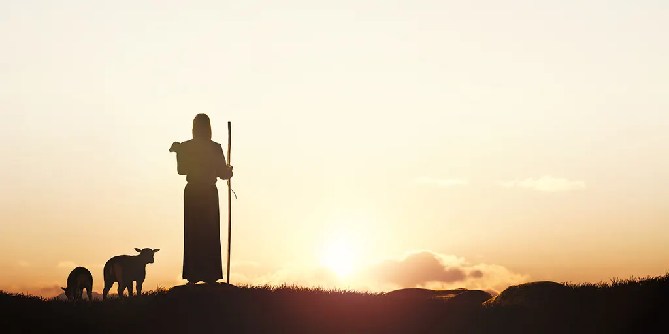
The Ninety-Nine and One
The Parables of Jesus Christ – The Lost Sheep
Luke 15:1-7
[10] For the Son of Man came to seek and to save the lost.…. Luke 19:10
“The Heart of a Sheperd”

Slide 2
The Lost souls…
1. Now the tax collectors and sinners were all gathering around to hear Jesus. 2. But the Pharisees and the teachers of the law muttered, “This man welcomes sinners and eats with them.” 3. Then Jesus told them this parable: 4. “Suppose one of you has a hundred sheep and loses one of them. Doesn’t he leave the ninety-nine in the open country and go after the lost sheep until he finds it? 5. And when he finds it, he joyfully puts it on his shoulders 6. and goes home. Then he calls his friends and neighbors together and says, ‘Rejoice with me; I have found my lost sheep.’ 7. I tell you that in the same way there will be more rejoicing in heaven over one sinner who repents than over ninety-nine righteous persons who do not need to repent. Luke 15:1-7

Slide 3
Who are the Lost Souls?
Those who are blinded by the god of this world –In their case the god of this world has blinded the minds of the unbelievers, to keep them from seeing the light of the gospel of the glory of Christ, who is the image of God.… 2 Corinthians 4:4
Those who came to Christ but left because of cares of life – Still others, like seed sown among thorns, hear the word; [19] but the worries of this life, the deceitfulness of wealth and the desires for other things come in and choke the word, making it unfruitful.…Mark:18-19
Those who doubt they is no God – The fool says in his heart, “There is no God.” They are corrupt, they do abominable deeds; there is none who does good. [2] The Lord looks down from heaven on the children of man, to see if there are any who understand, who seek after God…. Psalms 14:1-2
Those who have refused to repent – Now after John was arrested, Jesus came into Galilee, proclaiming the gospel of God, [15] and saying, “The time is fulfilled, and the kingdom of God is at hand; repent and believe in the gospel.…Mark 1:14-15

Slide 4
To seek and find the lost souls…
God Loves them – For God so loved the world, that he gave his only Son, that whoever believes in him should not perish but have eternal life. [17] For God did not send his Son into the world to condemn the world, but in order that the world might be saved through him. … John 3:16-17
God doesn’t desire that they Perish in Hell –The Lord is not slow to fulfill his promise as some count slowness, but is patient toward you, not wishing that any should perish, but that all should reach repentance. … 2 Peter 3:9
God wants them to live a fulfilled life – For the Gentiles seek after all these things, and your heavenly Father knows that you need them all. [33] But seek first the kingdom of God and his righteousness, and all these things will be added to you.… Matthew 6:32-33
God wants to use them to show case His Glory and Power – [10] For we are his workmanship, created in Christ Jesus for good works, which God prepared beforehand, that we should walk in them. … Ephesians 2:10

Slide 5
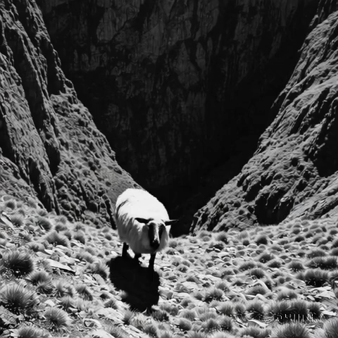
The Heart of a Sheperd
Retrospect…
The Value of one Sheep – Every Life Matters
The Relentless Love of the Sheperd - His Pursuit– God’s relentless love towards us
The Joy of Finding the Lost Sheep
I tell you that in the same way there will be more rejoicing in heaven over one sinner who repents than over ninety-nine righteous persons who do not need to repent.. Luke 15:7

Slide 6
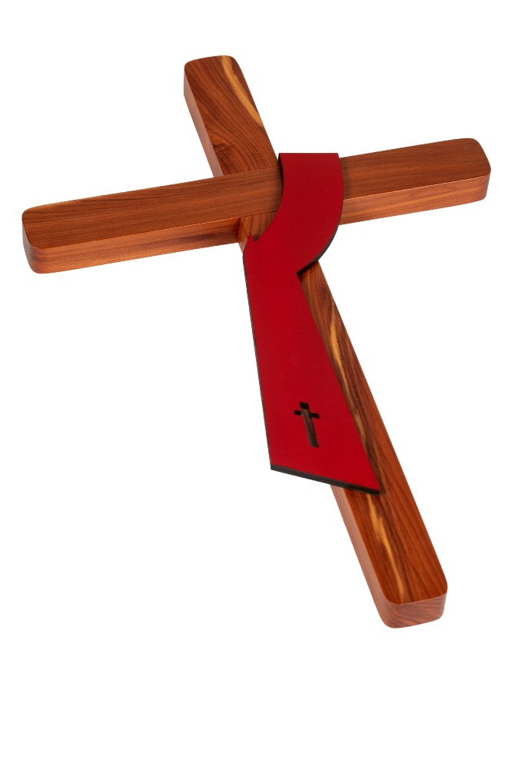
Saved by His Mercy….
Retrospect…
Now I'm alive to tell the story How I've overcome It's goodness and mercy And the power of the blood I'm so glad that my freedom Wasn't based on what I've done But the goodness and mercy And the power of the blood Oh, the power of my Savior's blood Oh, its was Jesus' blood, Jesus' blood
Was the cross meant for me? That my Savior carried Now I've been made free By the mercy of God Was the grave meant for me? Where my sin lay buried Now I stand redeemed By the mercy of God
5.not by works of righteousness which we have done, but according to his mercy he saved us, by the washing of regeneration, and renewing of the Holy Ghost; 6. which he shed on us abundantly through Jesus Christ our Saviour; 7. that being justified by his grace, we should be made heirs according to the hope of eternal life. .. Titus 3:5-7

