Slide 1

Being Led by the Spirit I
Why the need?
¹⁴ For all who are led by the Spirit of God are sons of God.
Romans 8:14

Slide 2
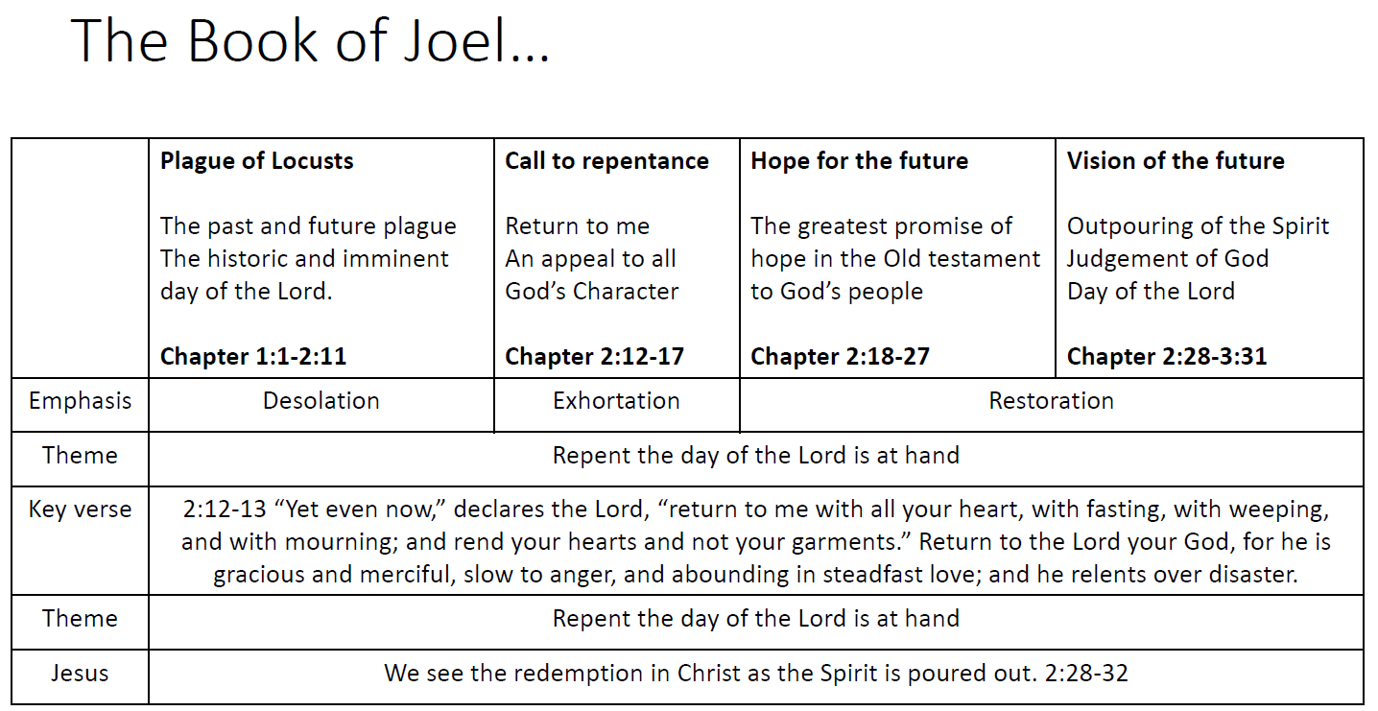
Recap ...

Slide 3
Why should I be led by the Spirit?
Who are you?
What’ s your mandate?
How can you fulfill this mandate?
²⁶ And God said, Let us make man in our image, after our likeness: and let them have dominion over the fish of the sea, and over the fowl of the air, and over the cattle, and over all the earth, and over every creeping thing that creepeth upon the earth. Genesis 1:26 (KJV)
⁷ And the Lord God formed man of the dust of the ground, and breathed into his nostrils the breath of life; and man became a living soul. Genesis 2:7 (KJV)
⁴ Now the word of the Lord came to me, saying, ⁵ “Before I formed you in the womb I knew you, and before you were born I consecrated you; I appointed you a prophet to the nations.” Jeremiah 1:4-5

Slide 4
Why should I be led by the Spirit?
Who are you?
The principle of first occurrence “formed”
Genesis 2:7 – “yatsar” (Hebrew (יצר) – to mould into form
Jeremiah 1:5 – “yatsar” (Hebrew (יצר) – to mould into form
²⁴ God is a Spirit [“pnyoo'-mah” (Greek {πνεῦμα})]: and they that worship him must worship him in spirit [“pnyoo'-mah” (Greek {πνεῦμα})] and in truth. John 4:24 (KJV)
³ Blessed are the poor in spirit [“pnyoo'-mah” (Greek {πνεῦμα})]: for theirs is the kingdom of heaven. Matthew 5:3
² And the earth was without form, and void; and darkness was upon the face of the deep. And the Spirit [“ruwach” (Hebrew (רוח)] of God moved upon the face of the waters. Genesis 1:2 (KJV)
⁷ Then shall the dust return to the earth as it was: and the spirit [“ruwach” (Hebrew (רוח)] shall return unto God who gave it. Ecclesiastes 12:7 (KJV)

Slide 5
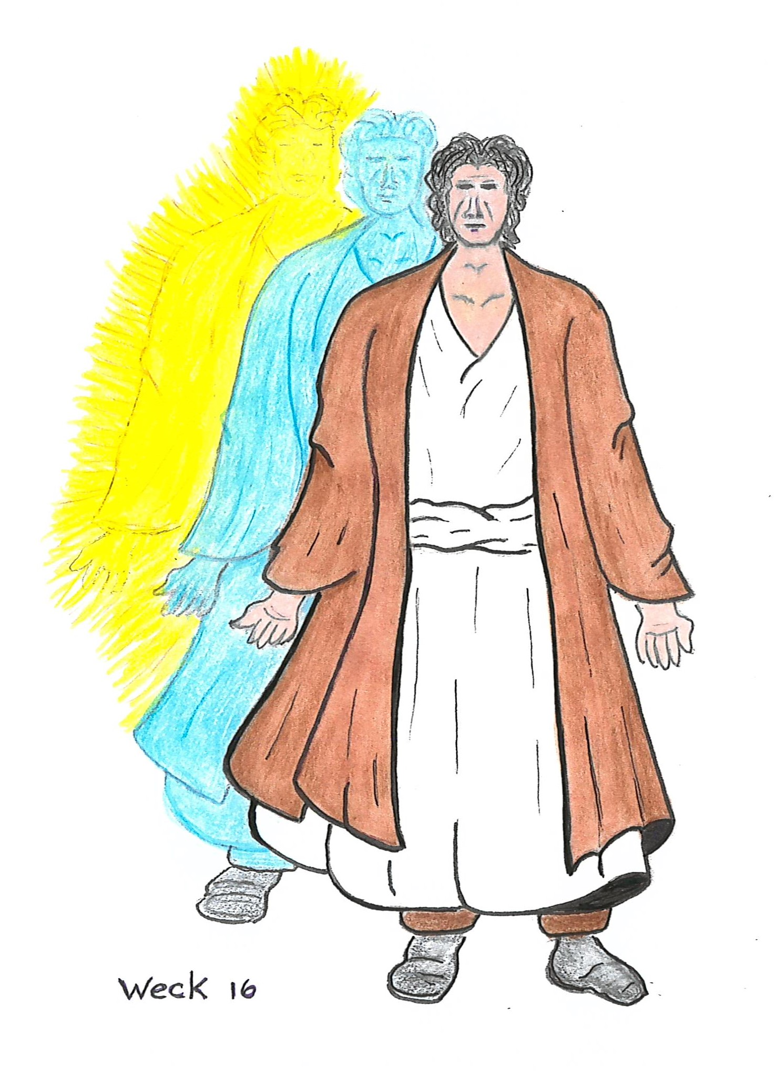
Why should I be led by the Spirit?
Who are you?
²³ And the very God of peace sanctify you wholly; and I pray God your whole spirit [“pnyoo'-mah” (Greek {πνεῦμα})] and soul and body be preserved blameless unto the coming of our Lord Jesus Christ. 1 Thessalonians 5:23 (KJV)
Therefore, you are:
a spirit being – heart
have a soul – intellect/emotion/will
live in a body – physical nature
²⁰ The soul that sinneth, it shall die. The son shall not bear the iniquity of the father, neither shall the father bear the iniquity of the son: the righteousness of the righteous shall be upon him, and the wickedness of the wicked shall be upon him. Ezekiel 18:20 (KJV)

Slide 6
Why should I be led by the Spirit?
What’ s your mandate?
⁴ Hear, O Israel: The Lord our God is one Lord: ⁵ And thou shalt love the Lord thy God with all thine heart, and with all thy soul, and with all thy might. Deuteronomy 6:4-5 (KJV)
¹³ Let us hear the conclusion of the whole matter: Fear God, and keep his commandments: for this is the whole duty of man. Ecclesiastes 12:13-14 (KJV)
³ Know that the Lord, he is God! It is he who made us, and we are his; we are his people, and the sheep of his pasture. ⁴ Enter his gates with thanksgiving, and his courts with praise! Give thanks to him; bless his name! Psalm 100:3-4
²⁷ And I will put my spirit within you, and cause you to walk in my statutes, and ye shall keep my judgments, and do them. Ezekiel 36:27 (KJV)
²⁸ And it shall come to pass afterward, that I will pour out my spirit upon all flesh; and your sons and your daughters shall prophesy, your old men shall dream dreams, your young men shall see visions: Joel 2:28 (KJV)

Slide 7
Why should I be led by the Spirit?
How can I fulfill this mandate?
³ Jesus answered and said unto him, Verily, verily, I say unto thee, except a man be born again, he cannot see the kingdom of God. ⁴ Nicodemus saith unto him, How can a man be born when he is old? Can he enter the second time into his mother's womb, and be born? ⁵ Jesus answered, Verily, verily, I say unto thee, except a man be born of water and of the Spirit, he cannot enter into the kingdom of God. ⁶ That which is born of the flesh is flesh; and that which is born of the Spirit is spirit. John 3:3-6 (KJV)
²² And no one puts new wine into old wineskins. If he does, the wine will burst the skins—and the wine is destroyed, and so are the skins. But new wine is for fresh wineskins. Mark 2:22 (ESV)
⁸ But ye shall receive power, after that the Holy Ghost is come upon you: and ye shall be witnesses unto me both in Jerusalem, and in all Judaea, and in Samaria, and unto the uttermost part of the earth. Acts 1:8 (KJV)
It’s impossible to fulfill our God given mandate without a rejuvenated spirit.

Slide 8
Why should I be led by the Spirit?
How can I fulfill this mandate?
I beseech you therefore, brethren, by the mercies of God, that ye present your bodies a living sacrifice, holy, acceptable unto God, which is your reasonable service. Romans 12:1 (KJV)
⁶ For to be carnally minded is death; but to be spiritually minded is life and peace. ⁷ Because the carnal mind is enmity against God: for it is not subject to the law of God, neither indeed can be. ⁸ So then they that are in the flesh cannot please God. Romans 8:6-8 (KJV)
²⁵ If we live in the Spirit, let us also walk in the Spirit. Galatians 5:25 (KJV)
¹⁴ For all who are led by the Spirit of God are sons of God. Romans 8:14

Slide 9
Why should I be led by the Holy Spirit?
Because:
You are a spirit being and your spirit needs to be restored back to God in a glorious form via salvation in Jesus Christ.
Your soul which comprises of your intellect, emotion, and will needs to go through the process of sanctification by the Holy Spirit.
For empowerment (fruit bearing and talent manifestation) using the physical body as instrument of righteousness
Prayer …………….

